Slide 1
Social Context of computing

Slide 2

Historical Development:
Early Computational Tools:
Abacus (c. 2700–2300 BCE): One of the earliest known computing tools, facilitating arithmetic calculations.
Antikythera mechanism (c. 100 BCE): An ancient Greek analog computer used for astronomical calculations.

Slide 3
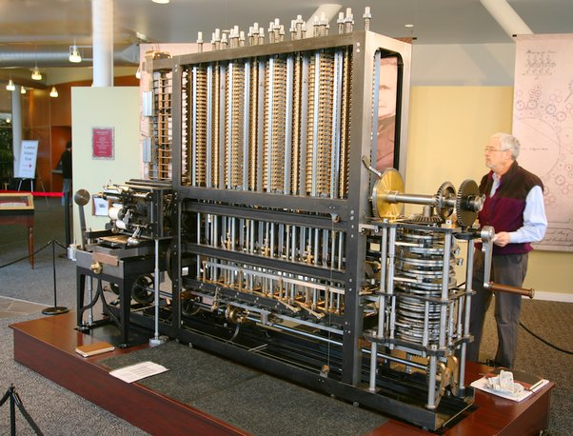
Historical Development:
Mechanical Era:
Pascaline (1642): Invented by Blaise Pascal, one of the first mechanical calculators capable of addition and subtraction.
Difference Engine and Analytical Engine (19th century): Charles Babbage's designs laid the groundwork for mechanical computing, with Ada Lovelace contributing programming concepts.

Slide 4
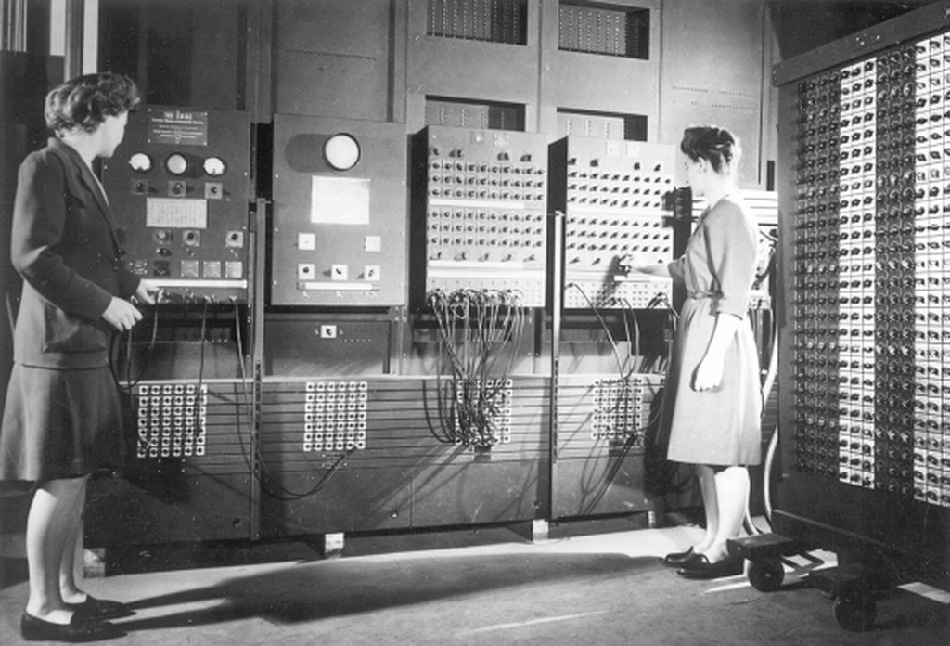
Historical Development:
Electromechanical and Electronic Era:
Harvard Mark I (1944): An electromechanical computer that marked a significant step towards more complex computing machines.
ENIAC (1946): Among the first electronic general-purpose computers, signaling the onset of the electronic computing era.

Slide 5
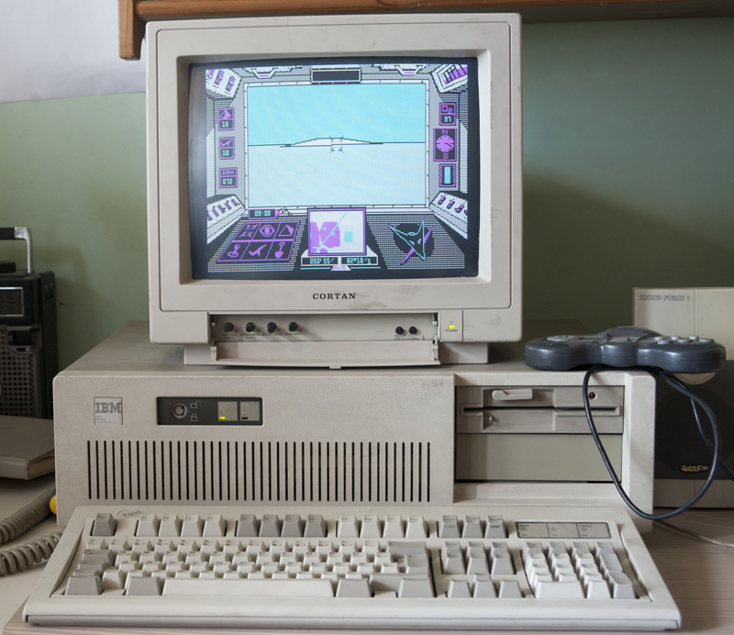
Historical Development:
The Advent of Personal Computing:
Microprocessors (1970s): Enabled the development of personal computers, democratizing access to computing technology.
Apple II (1977) and IBM PC (1981): Popularized personal computing, impacting businesses, education, and home entertainment.

Slide 6
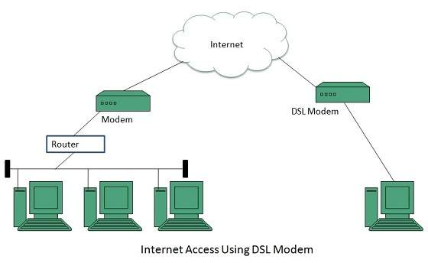
Historical Development:
Internet and Connectivity:
ARPANET (1969): The precursor to the internet, facilitating data sharing and communication across distant computers.
World Wide Web (1989): Revolutionized information access and connectivity, profoundly influencing society.

Slide 7
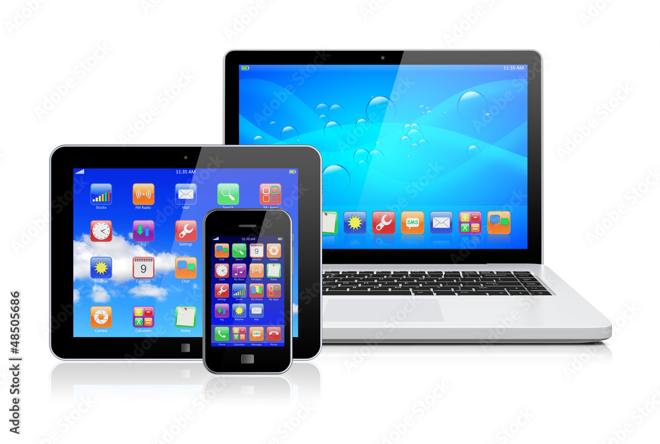
Historical Development:
Mobile and Ubiquitous Computing:
Smartphones and Tablets: Transformed communication, entertainment, and information access, becoming integral to daily life.
IoT (Internet of Things): Expanded computing to everyday objects, enhancing connectivity and data exchange.

Slide 8
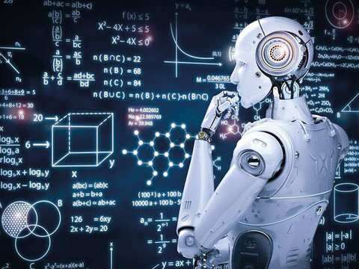
Historical Development:
AI and Machine Learning:
Evolution of AI: From theoretical foundations to practical applications, influencing sectors like healthcare, finance, and transportation.
Machine Learning and Big Data: Advanced data analysis and predictive models, fostering innovations across various industries.

Slide 9

Digital Divide:
1. Access Disparities:
The digital divide refers to the gap between individuals who have access to modern information and communication technology (ICT) and those who do not.
Factors like socioeconomic status, geographic location, and educational level significantly influence access to computing technology.

Slide 10

Digital Divide:
2. Impacts:
Lack of access can exacerbate educational and economic disparities, limiting opportunities for employment, learning, and social participation.
Regions with limited technology access struggle to keep pace with more connected areas, hindering overall development.

Slide 11
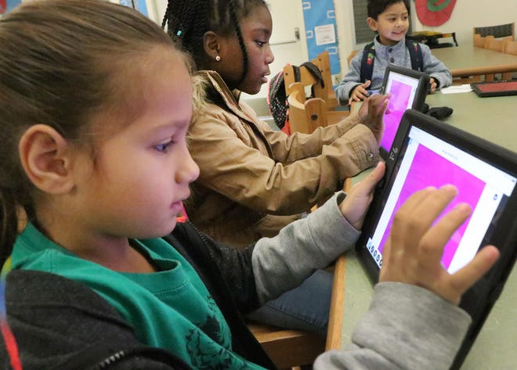
Digital Divide:
3. Bridging Strategies:
Infrastructure Development: Investing in ICT infrastructure, particularly in underserved areas, to ensure widespread, reliable internet and technology access.
Affordability: Implementing policies and programs that make technology and internet access more affordable for low-income populations.
Education and Training: Providing digital literacy programs to equip all demographics with the necessary skills to utilize technology effectively.

Slide 12

Ethical Considerations:
Data Privacy:
Concerns how personal information is collected, processed, stored, and shared, emphasizing the need for consent, security, and user rights protection.
Surveillance:
Involves monitoring user activities, often justified by security needs but raising concerns about privacy infringement and the need for proper legal frameworks and transparency.
Intellectual Property:
Addresses the protection of creative works and innovations in ICT, balancing the rights of creators with public access, and includes issues related to copyright infringement and the ethical use of open-source resources.
AI Ethics:
Focuses on ensuring that AI systems are developed and deployed in a manner that is fair, accountable, and transparent, addressing concerns about bias, discrimination, and the broader societal impacts of AI technology.

Slide 13
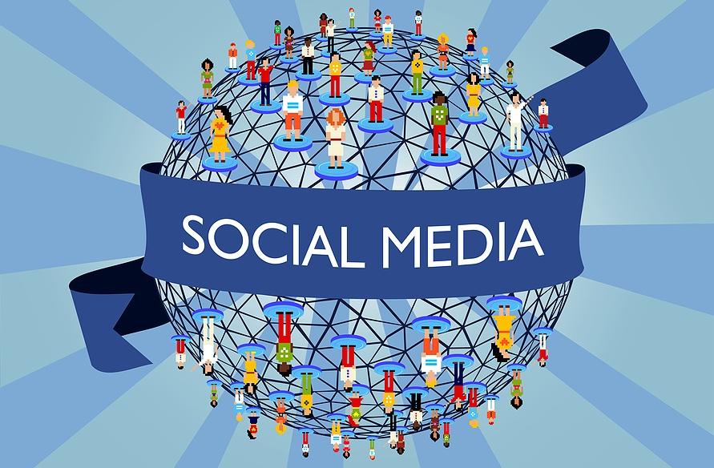
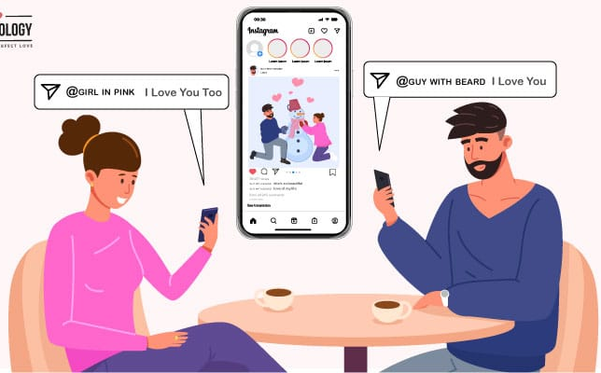

Social Media and Communication:
Influence on Public Opinion and Culture:
Social media platforms significantly affect how information is disseminated and consumed, influencing public opinion, cultural trends, and societal norms.
Key Issues:
Cyberbullying: The use of digital platforms to harass, intimidate, or demean individuals, raising concerns about mental health and safety.
Misinformation: The spread of false or misleading information, which can distort public perception and affect democratic processes.
Digital Well-being: Addressing the psychological and emotional impact of excessive social media use, including addiction and social isolation.
Privacy and Relationships:
Social media can compromise user privacy through data collection and sharing practices, affecting trust and personal security.
The nature of personal relationships is evolving, with social media offering new ways to connect while also posing challenges to intimacy and genuine interaction.

Slide 14
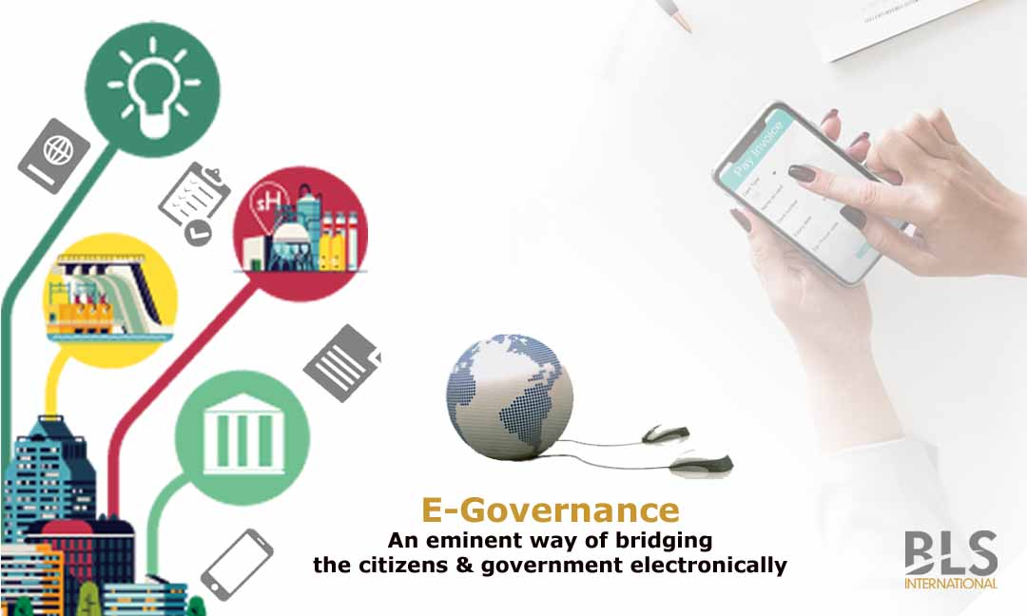
E-Government and Civic Engagement:
Digital Platforms for Civic Engagement:
E-government uses online portals and digital services to offer public services efficiently, enabling easier access to information, services, and resources for citizens.
Enhancing Transparency and Participation:
Technology fosters greater transparency by making government operations more visible and accessible to the public.
It also empowers citizen participation by providing platforms for feedback, engagement in decision-making processes, and direct communication with representatives.

Slide 15

Work and Employment:
Automation and AI:
These technologies are reshaping employment, replacing some jobs while creating others, and generally demanding new skills, thereby affecting job quality and worker requirements.
Remote Work:
Offers flexibility and reduces commuting, but also poses challenges in terms of isolation, overwork, and blurring the boundaries between professional and personal life, impacting work-life balance.
Gig Economy:
Digital platforms have enabled the rise of gig work, providing flexible employment opportunities but also raising concerns about job security, benefits, and worker rights.

Slide 16

Accessibility and Inclusivity:
Accessible Technology:
Involves designing computing products and environments to be usable by people with various disabilities, ensuring equal access to information and functionality.
Inclusivity in Computing:
Emphasizes the need for technologies to accommodate a wide range of user needs and preferences, reflecting different cultural contexts and promoting equality in the digital realm.

Slide 17
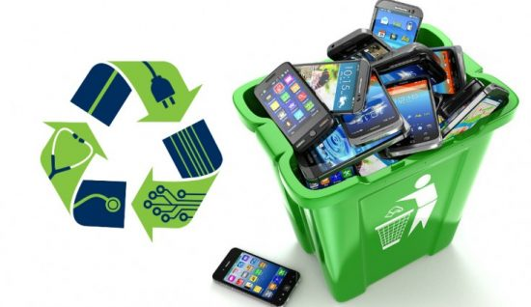
Environmental Impact:
Carbon Footprint:
Data centers and digital infrastructure consume significant energy, contributing to greenhouse gas emissions. Efforts to reduce this impact include using renewable energy sources and improving energy efficiency.
E-Waste Management:
Proper disposal and recycling of electronic waste are crucial to mitigate harmful environmental effects and promote the sustainability of computing technologies.

Slide 18
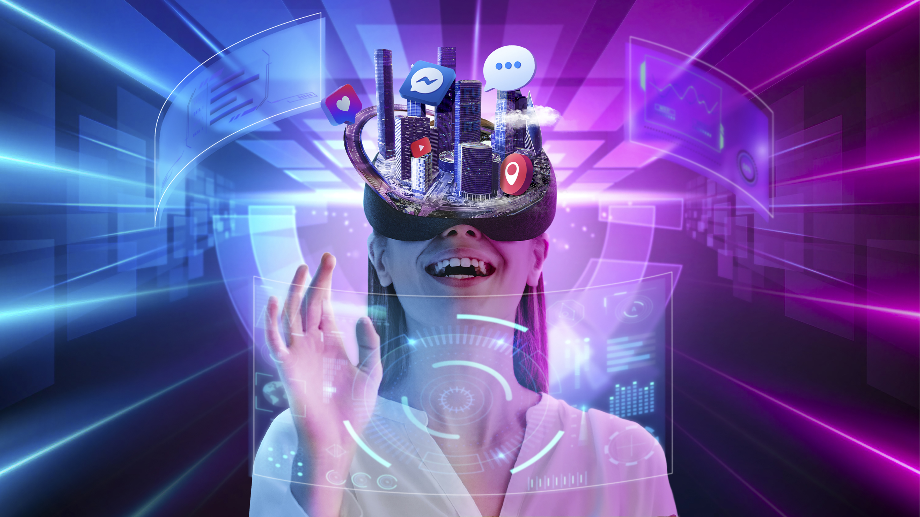
Future Directions:
Emerging Technologies:
Innovations like quantum computing, blockchain, and extended reality (XR) promise to transform industries, society, and day-to-day life, raising questions about their broader implications.
Collaborative Shaping of the Future:
Policymakers, technologists, and the public must work together to ensure that advances in computing benefit society as a whole, addressing ethical, legal, and social considerations proactively.

